Slide 1
Virtual DJ
SSP 115 Final Project
Doug Chang & Joseph Smarr
Spring 2001

Slide 2
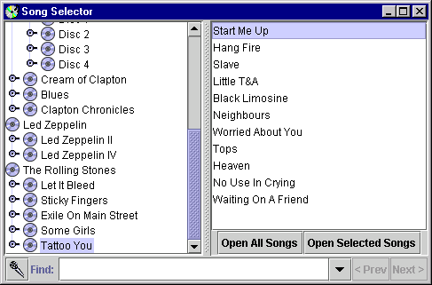
Project Overview
Talk to your computer like it was a human DJ:
vs: “Play Start Me Up”

Slide 3
Motivation
Take advantage of the efficiency and flexibility of voice
  Quickly say things that would take a long time to “click through”
  Be brief and to-the-point; let the computer figure out what you meant
Explore the ease of integration with voice and existing applications

Slide 4
Our Implementation
Natural grammar interface:
  “Play Purple Haze”
  “Put on Dark Side of the Moon”
  “Play some Metallica”
  “Play something by Eminem”
Minimally invasive UI:
  Click the microphone button and start talking

Slide 5
Challenges We Faced
“Half-duplex” sound card prevents recognition while music is playing
  Can’t issue corrections or follow-ups
Many titles are hard to pronounce
  The Wall – Disc 1 (dash and number)
  L.A. Woman (acronym with periods)
  Led Zeppelin IV (roman numeral)
  10,000 Maniacs (number)
  Ella Fitzgerald & Louis Armstrong (ampersand)

Slide 6
Successes & Surprises
Recognition is fast, accurate, and fun!
Auto-pronunciation is great, including for:
  Eminem
  Abraxas
  Metallica
  The Hoochie Coochie Man
  Oye Como Va
Using JavaSpeechChannel is very easy

Slide 7
Integration with JSC is a Snap!
Recipe for adding voice to your favorite app:
  Initialize a new NuanceSpeechChannel
  Call playAndRecognize()
  Pull out the slot values and handle them
Outside of disambiguation and error handling,
integrating speech recognition amounted to
less than a dozen lines of code!

Slide 8
Ideas for the Future
Smarter Language Model
  Weight recognition by user listening habits
Intelligent follow-up prompts:
  e.g. “the live version or the studio version?”
Dynamically generate grammar
  Include only titles in user’s music collection

